Slide 1
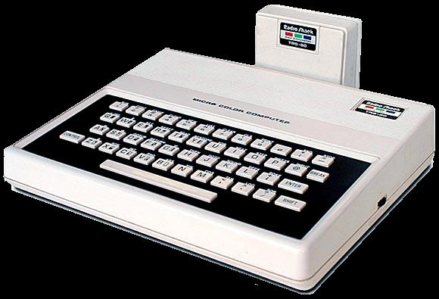
Assembly Language Programming on the TRS-80 MC-10
Using the Virtual MC-10
and the TASM compiler

Slide 2
Getting Started
Pre-requisites for the tutorial.
  Virtual MC-10 version 0.7 or higher
  Familiarity with MICROCOLOR BASIC 1.0
  (this is the basic that comes with the MC-10)
  Basic knowledge of “hexadecimal numbers”
  A text editor. This tutorial uses the “Notepad” editor that comes bundled with Microsoft Windows.

Slide 3
Getting Started
Download the Virtual MC-10
  As of 2008, the emulator can be found at http://www.geocities.com/emucompboy.
  Find and download the “Virtual MC-10”
  Follow any additional installation instructions that come with the emulator
  A good book on assembly is helpful, but hopefully not required. I found William Barden Jr.’s “Assembly Language on the TRS-80 Color Computer” to be very helpful.

Slide 4
Hexadecimal Numbers
Good tutorials exist on the web for hexadecimal numbers.
The Virtual MC-10 and the bundled TASM compiler use a “$” pre-fix to distinguish a hexadecimal representation of a number from its decimal equivalent.
The tutorials slowly introduce hexadecimal (and binary) numbers over time.
The sections involving the video display modes and memory map use hexadecimal numbers almost exclusively.
The Virtual MC-10 debug windows displays information primarily with hexadecimal numbers, but usually also displays their decimal equivalents.

Slide 5
Other Material
A good book on assembly is helpful, but hopefully not required.
William Barden Jr.’s “Assembly Language Programming on the TRS-80 Color Computer” covers the MC-10’s “big brother” (the MC6809E processor found in the CoCo).
You may also find good information if you search for “6800 assembly tutorial” on the internet. The MC-10 uses a 6801 processor, which has only a few additional instructions.

Slide 6
MC-10 Hardware
The CPU: (Motorola MC6803)
A video display chip (Motorola MC6847)
On board memory shared between the MC6803 and MC6847) totalling 4K
An input/ouput buffer to control the RS232-C port and cassette port.
A latch to control the TV’s speaker
An expansion bus accessible by the CPU
The infamous “rubber chicklet” (a.k.a. “rubber chicken”) keyboard.

Slide 7
MC-10 Memory Map
Address
Component
$00-$FF
On-chip RAM
$0100-$03FF
Unused
$4000-$4FFF
4K Video RAM
$5000-$8FFF
16K Expansion
$9000-$BFFF
Video/Sound
Control
$C000-$DFFF
Mirror of ROM
$E000-$FFFF
BASIC ROM

Slide 8
On-Chip Memory
Address
Function
Description
$00
Port 1 Data Direction Register
Enables Keyboard (Set to 255)
$01
Port 2 Data Direction Register
Enables Keyboard (Set to 255)
$02
Port 1 Data Register
Keystrobe
$03
Port 2 Data Register
Keystrobe
$04-$07
Unused
$08
Timer Control and Status
Working!
$09-$0A
16-bit counter
Working!
$0B-$0C
Output Compare Register
Working!
$0D-$0E
Input Capture Register
Not emulated by VMC-10
$0F
Unused
$10
Rate and Mode Control
Not emulated by VMC-10
$11
Transceiver Control/Status
Not emulated by VMC-10
$12
Receive Data
Not emulated by VMC-10
$13
Transmit Data
Not emulated by VMC-10
$14
RAM Control Register
Not emulated by VMC-10
$15-$1F
Internal Registers
Not emulated by VMC-10
$20-$7F
Unused
$80-$FF
User RAM
Heavily used by BASIC

Slide 9
Video/Sound Control
49151
($BFFF)
7
6
5
4
3
2
1
0
Sound
CSS
A/G
GM0
GM1
GM2
INT/EXT
N/C
N/C
Operation is controlled by writing to any memory location between $9000-$BFFF (36864-49151).
The convention used by MC-10 programmers was to use $BFFF. This would have allowed programs to be backwards-compatible on any future version of the MC-10.
The speaker is energized / de-energized by setting bit 7 of the control register.
The remaining bits controls the various graphics mode of the MC6847 chip. (we will cover the graphics modes in a later section)

Slide 10
6803 Registers
A
B
15
8
7
0
D
15
0
X
15
0
S
15
0
PC
7
0
CCR
1
1
H
I
N
Z
V
C

Slide 11
Accumulator
A
B
15
8
7
0
D
15
0
Register D is known as the “double accumulator”
It a 16-bit register on which you can perform addition/subtraction.
You can also shift it left or right.
Register D is broken up into two eight bit registers:
A, the “high“ byte
B, the “low” byte
You can perform any arithmetic or bitwise operation on the 8-bit registers
Unsigned multiplication of A with B can be performed, the result is stored
in-place in the D register. There are no division instructions.

Slide 12
6803 Registers
15
0
X
Register X is a 16-bit register which contains an address
you can read from or write to.
You can also add a constant positive 8-bit offset to it and compare it
with other 16-bit values.

Slide 13
6803 Registers
15
0
S
Register S is known as the stack pointer.
It is intended to contain an address to a contiguous section of memory
known as the stack. The stack can only grow or shrink in size from one
end. You can “push” or “pull” information from the top of the stack.
The stack is primarily used to keep track of subroutine addresses,
local variables, or temporary storage.

Slide 14
6803 Registers
15
0
PC
Register PC is the program counter
It contains the address of the next instruction to be executed.

Slide 15
6803 Registers
7
0
CCR
1
1
H
I
N
Z
V
C
Register CCR is the 8-bit condition code register.
The two most significant bits are always set to one.
The other six bits are updated after every instruction to contain status information.
Half-carry - facilitates binary coded decimal arithmetic
It is used by the DAA instruction.
Interrupt - prevents the timers from redirecting the PC
counter to a different code segment
Negative - indicates that a negative result occurred.
Zero - indicates that the result of the last instruction was zero.
oVerflow - indicates that the result could not be fit into an 8-bit signed number.
Carry - indicates that the result could not be fit into an 8-bit unsigned number.

Slide 16
6803 Instructions
aba beq bra daa jmp mul rol staa tst
abx bne brn dec jsr rola stab tsta
adca bcc deca neg rolb std tstb
adcb bcs cba decb ldaa nega ror sts
adda bhi clc des ldab negb rora stx wai
addb bhs cli dex ldd nop rorb suba
addd blo clr lds rti subb
anda bls clra eora ldx oraa rts subd
andb bge clrb eorb lsl orab swi
asr bgt clv lsla sba
asra ble cmpa inc lslb psha sbca tab
asrb blt cmpb inca lsld pshb sbcb tap
bmi cpx incb lsr pshx sec tba
bita bpl com ins lsra pula sei tpa
bitb bvc coma inx lsrb pulb sev tsx
bsr bvs comb lsrd pulx txs

Slide 17
Addressing Modes
Syntax Mode Instruction Size (bytes)
<opcode> (inherent) 1 byte
<opcode> #value (immediate) 1 byte + 1 or 2 byte value
<opcode> address (direct) 1 byte + 1 byte address
<opcode> address (extended) 1 byte + 2 byte address
<opcode> offset,x (indexed) 1 byte + 1 byte offset
<branch op> address (relative) 1 byte + 1 byte offset
Inherent - does not take an operand
Immediate - operand as data
Direct - operand as address to on-chip memory (<256)
Extended - operand as an address to off-chip memory (>255)
Indexed - add positive single byte offset to x, use result
as address
Relative - operand as an address up to 128 bytes before or 127 bytes
after the next instruction.

Slide 18
Cycle Counting
Indexed and extended instructions will take the same number of clock cycles.
Direct addressing instructions take one clock cycle less than either indexed or extended instructions.
Immediate addressing instructions take one less cycle than direct addressing.

Slide 19
Tutorial #1 – load/store
aba beq bra daa jmp mul rol staa tst
abx bne brn dec jsr rola stab tsta
adca bcc deca neg rolb std tstb
adcb bcs cba decb ldaa nega ror sts
adda bhi clc des ldab negb rora stx wai
addb bhs cli dex ldd nop rorb suba
addd blo clr lds rti subb
anda bls clra eora ldx oraa rts subd
andb bge clrb eorb lsl orab swi
asr bgt clv lsla sba
asra ble cmpa inc lslb psha sbca tab
asrb blt cmpb inca lsld pshb sbcb tap
bmi cpx incb lsr pshx sec tba
bita bpl com ins lsra pula sei tpa
bitb bvc coma inx lsrb pulb sev tsx
bsr bvs comb lsrd pulx txs

Slide 20
Load/Store Opcodes
ldaa - load 8-bit accumulator "a“
ldab - load 8-bit accumulator "b“
ldd - load 16-bit double accumulator "d“
ldx - load16-bit index register "x“
lds - load16-bit index register "x“
staa - store accumulator a
stab - store accumulator d
std - store double accumulator
stx - store x register
sts - store s register

Slide 21
Load/Store Opcodes
ldaa, ldab - can use direct, extended, indexed,
or 1 byte immediate.
ldd, ldx, lds - can use direct, extended, indexed,
or 2 byte immediate.
staa, stab, std, stx, sts
- can use only direct, extended or indexed modes.

Slide 22
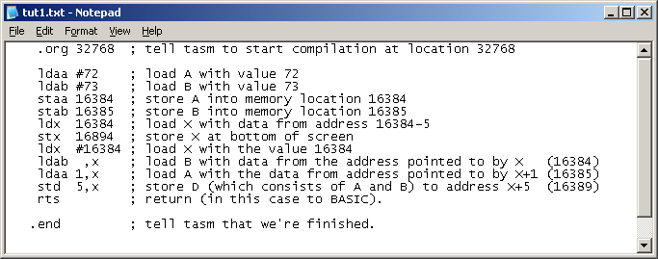
Example Program
We’ll ignore the S, PC, and CCR registers for now, and just focus on the
accumulator and index registers…we’ll learn more about the stack and
condition codes later.
Here’s an example – note the spaces at the beginning of each line.
The MC-10’s text display starts at location $4000 (16384) and ends
at $41FF (16895).
Let’s write 72(H) and 73(I) to the screen in various locations:

Slide 23
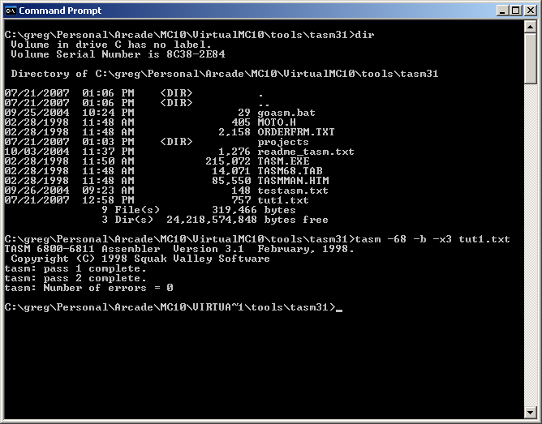
Use TASM to compile

Slide 24
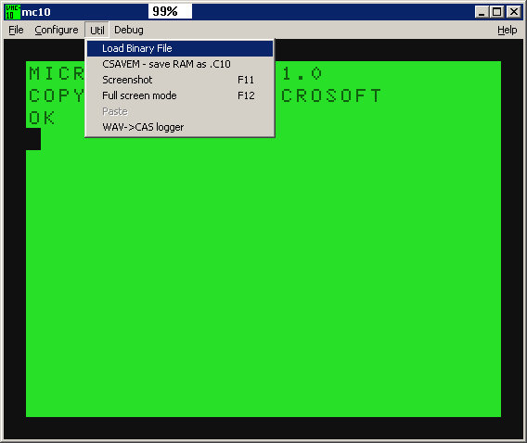
Use Virtual MC-10 to read in

Slide 25
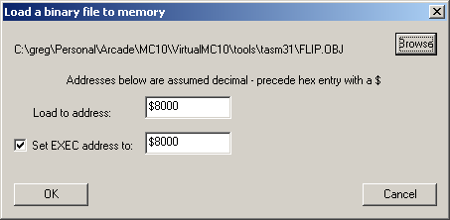
Browse to get your object

Slide 26
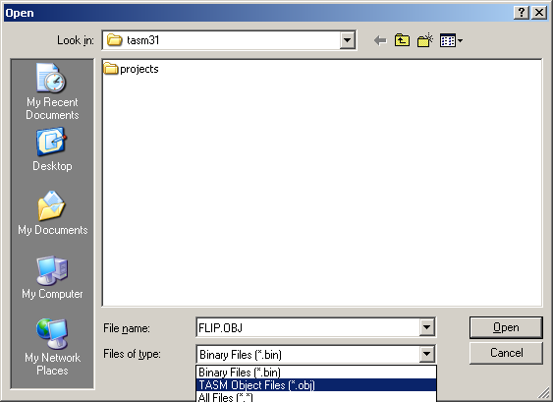
Look for TASM *.obj files

Slide 27
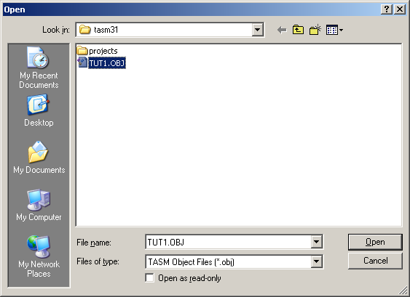
Open the obj file

Slide 28
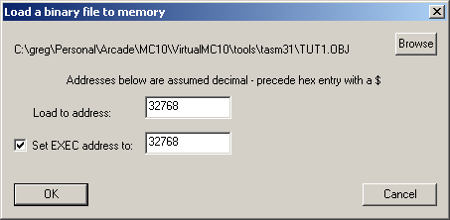
Now set where it should go

Slide 29
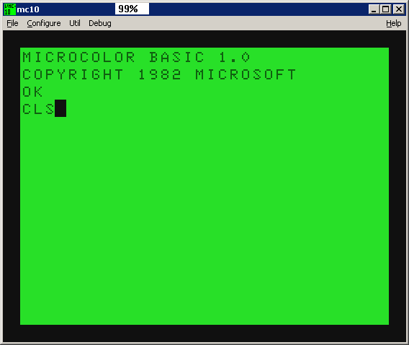
Clear the screen

Slide 30
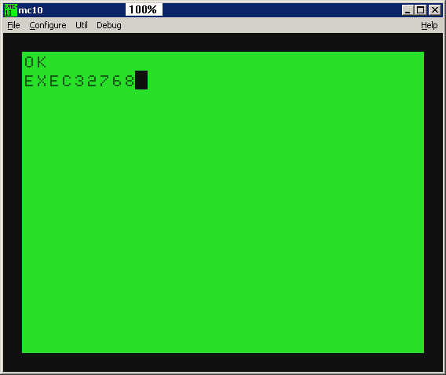
Now run your program

Slide 31
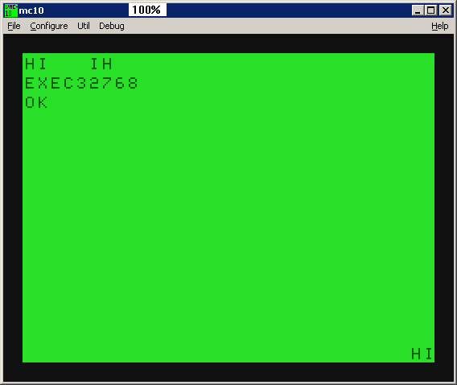
Ta-da!

Slide 32
Here’s the program and its output.

Slide 33
Using the debugger
The Virtual MC-10’s debugger has several windows:
  Register
  Memory
  History
  Disassembly
  Breaks
  LST (program listing)
  Script
  Map/Level

Slide 34
Using the debugger
The Virtual MC-10’s debugger has several windows:
  Register
  Memory
  History
  Disassembly
  Breaks
  LST (program listing)
  Script
  Map/Level

Slide 35
Tutorial #2
Increment and Decrement
aba beq bra daa jmp mul rol staa tst
abx bne brn dec jsr rola stab tsta
adca bcc deca neg rolb std tstb
adcb bcs cba decb ldaa nega ror sts
adda bhi clc des ldab negb rora stx wai
addb bhs cli dex ldd nop rorb suba
addd blo clr lds rti subb
anda bls clra eora ldx oraa rts subd
andb bge clrb eorb lsl orab swi
asr bgt clv lsla sba
asra ble cmpa inc lslb psha sbca tab
asrb blt cmpb inca lsld pshb sbcb tap
bmi cpx incb lsr pshx sec tba
bita bpl com ins lsra pula sei tpa
bitb bvc coma inx lsrb pulb sev tsx
bsr bvs comb lsrd pulx txs

Slide 36
Increment instructions
inca – increment register a (a = a+1)
incb – increment register b (b = b+1)
inx – increment register x (x = x+1)
ins – increment register s (s = s+1)
inc address – increment contents of specified 2 byte address
inc offset,x – increment contents of address pointed to by adding X and the
single-byte offset

Slide 37
Decrement instructions
deca – decrement register a (a = a - 1)
decb – decrement register b (b = b - 1)
dex – decrement register x (x = x - 1)
des – decrement register s (s = s - 1)
dec address – decrement contents of the specified 2 byte address
dec offset,x – decrement contents of address pointed to by adding x and the
single-byte offset

Slide 38
Rollover
Incrementing a byte that contains the highest value (255) will roll it over to 0.
Decrementing a byte that contains the lowest value (0) will roll it back to 255.
Two-byte words (x, s) will “roll over” between the values of 0 and 65535

Slide 39
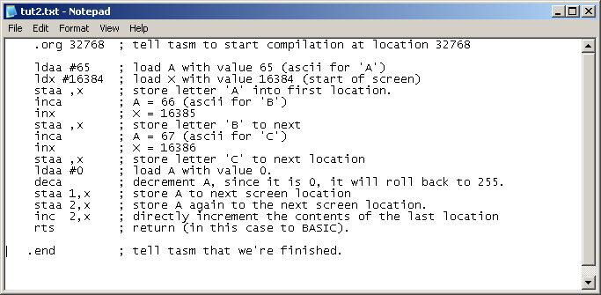
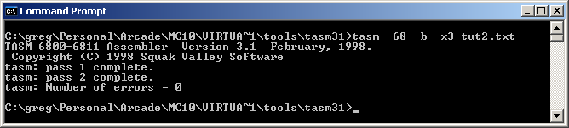
Example program

Slide 40
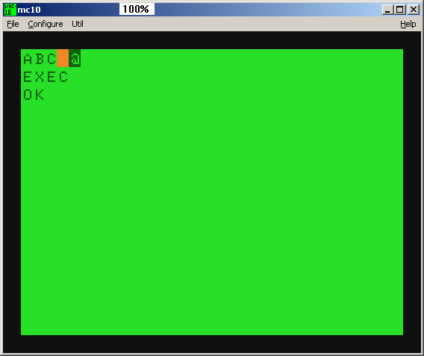
Output

Slide 41
Output
65
66
67
255
0

Slide 42
Tutorial #3 and #4
Addition
aba beq bra daa jmp mul rol staa tst
abx bne brn dec jsr rola stab tsta
adca bcc deca neg rolb std tstb
adcb bcs cba decb ldaa nega ror sts
adda bhi clc des ldab negb rora stx wai
addb bhs cli dex ldd nop rorb suba
addd blo clr lds rti subb
anda bls clra eora ldx oraa rts subd
andb bge clrb eorb lsl orab swi
asr bgt clv lsla sba
asra ble cmpa inc lslb psha sbca tab
asrb blt cmpb inca lsld pshb sbcb tap
bmi cpx incb lsr pshx sec tba
bita bpl com ins lsra pula sei tpa
bitb bvc coma inx lsrb pulb sev tsx
bsr bvs comb lsrd pulx txs

Slide 43
Unsigned Addition
Addition shares the same “rollover” properties as incrementing.
You may add values to the A, B, or D accumulators (adda, addb, addd)
You can add to the contents of the A register by the contents of the B (aba).
You can add the B register (unsigned) to the contents of the X register (abx)

Slide 44
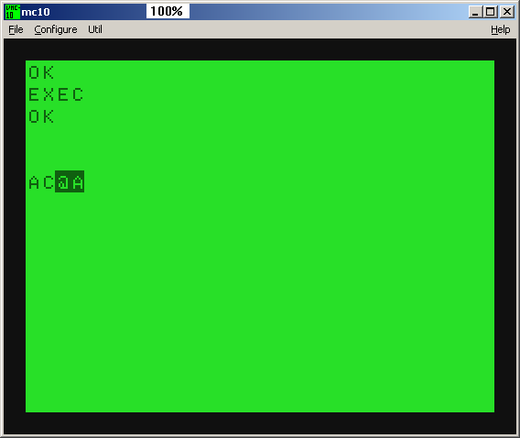
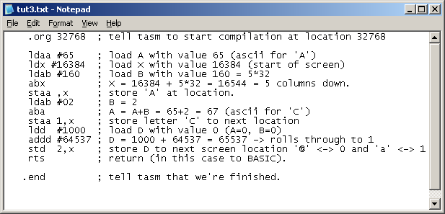
Tutorial #3 – unsigned addition

Slide 45
Tutorial #4 Signed Addition
The “rollover” property can be used to construct negative numbers.
We will first discuss an odometer which rolls over at 1000000 miles.
We’ll then apply this to our 8-bit and 16-bit accumulators which rollover at 256 and 65536.

Slide 46
Odometer Example
Consider an old fashioned odometer that goes from 000000 to 999999.
If you drive exactly 1000000, 2000000, 3000000 or any multiple of 1000000 miles, the odometer will go back to 000000.
9
9
9
9
9
9
0
0
0
0
0
0

Slide 47
Odometer Example
If your odometer is at, say, 83014 miles, and you drive exactly 1000000 miles, then the odometer will still read 83014.
083014
+1000000 miles
083014

Slide 48
Odometer Example
If your odometer is at, say, 83014 miles, and you drive exactly 999999 miles, then the odometer will read read 83013.
Note that adding 999999 is the same as adding -1.
083014
+999999
083013
X
+999999
X-1
X
-1
X-1

Slide 49
Odometer Example
If your odometer is at, say, 83014 miles, and you drive exactly 999998 miles, then the odometer will read read 83012.
Note that adding 999998 is the same as adding -2.
083014
+999998
083012
X
+999998
X-2
X
-2
X-2

Slide 50
Odometer Example
This suggests the following relationship:
  X = 1000000 – X
Thus if your “odometer” only has positive numbers, you can use the “rollover” property to find the equivalent negative number.

Slide 51
Odometer Example
Let’s say your odometer is at 999998 miles. If you drive 5 miles, you’ll end up with a reading of 000003 miles.
Note the equivalency again of 999998 = -2
999998
+ 5
000003
-2
+ 5
3

Slide 52
8-bit Odometer
A single byte roll-over occurs at 256.
Thus,
-X = 256 – X (single-byte)
By convention, numbers 0, 1, 2, …,127 are considered “positive”
Numbers 128, 129, 130, …, 253, 254, 255 are considered “negative” and correspond to values -128, -127, -126, …, -3, -2, -1.
Note that +128 cannot be represented with this convention, but -128 can.

Slide 53
8-bit Negation Instructions
You can negate the value of either the A or B register (nega, negb)
You can negate an address
ldaa #10 ; A holds 10
nega ; A holds -10 (246 = 256-10)
neg 16384 ;negate first screen char
neg ,X ; negate what X points to

Slide 54
16-bit Odometer
A double byte roll-over occurs at 65536.
Thus,
-X = 65536 – X (double-byte)
By convention, numbers 0, 1, 2, …, 32767 are considered “positive”
Numbers 32768, 32769, 32770, …, 65533, 65534, 65535 are considered “negative” and correspond to values -32768, -32767, -32766, …, -3, -2, -1.
Note that -32768 is in this set, but that +32768 cannot be.
Sadly, there is no 16-bit negation instruction

Slide 55
Signed arithmetic
Like driving the car, addition and subtraction with rollover don’t really care if you consider your numbers as signed or unsigned. The computer will blindly increment or decrement its “internal odometer” the specified number of times, and leave you with the result, which you can use either as signed or unsigned depending on your needs.

Slide 56
Negative Operands
The TASM compiler will gladly accept negative numbers to instructions that take immediate operands.
It will automatically convert them to their ‘unsigned’ equivalents depending on whether the particular instruction expects a 8-bit or 16-bit operand.
    ldaa #-1 -> ldaa #255
    addd #-3 -> addd #65533

Slide 57
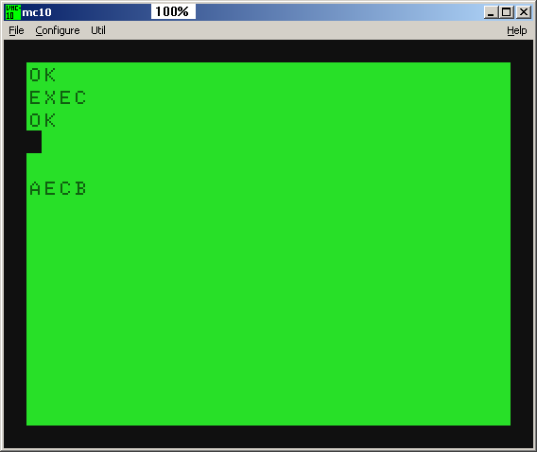
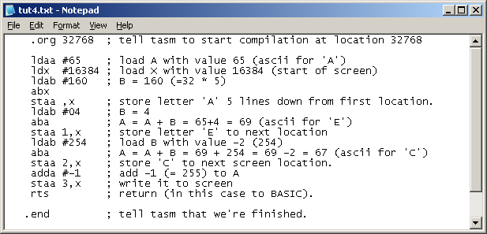
Example #4 - Signed Addition

Slide 58
Tutorial #5
Subtraction
aba beq bra daa jmp mul rol staa tst
abx bne brn dec jsr rola stab tsta
adca bcc deca neg rolb std tstb
adcb bcs cba decb ldaa nega ror sts
adda bhi clc des ldab negb rora stx wai
addb bhs cli dex ldd nop rorb suba
addd blo clr lds rti subb
anda bls clra eora ldx oraa rts subd
andb bge clrb eorb lsl orab swi
asr bgt clv lsla sba
asra ble cmpa inc lslb psha sbca tab
asrb blt cmpb inca lsld pshb sbcb tap
bmi cpx incb lsr pshx sec tba
bita bpl com ins lsra pula sei tpa
bitb bvc coma inx lsrb pulb sev tsx
bsr bvs comb lsrd pulx txs

Slide 59
Subtraction
Subtraction shares the same “rollover” properties as decrementing.
You may subtract
  values from the A, B, or D accumulators (suba, subb, subd)
  the contents of the A register by the contents of the B. (sba)
Unfortunately, there is no corresponding sbx instruction that subtracts the B register from the X.

Slide 60

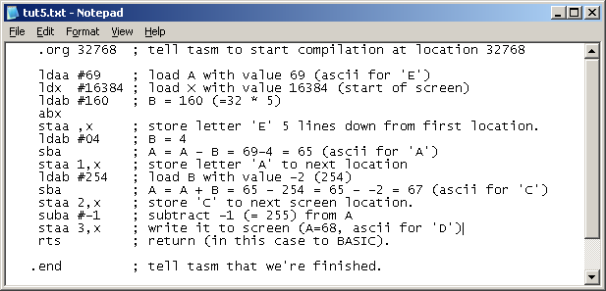
Example #5
Subtraction

Slide 61
Tutorial #6
Branch Instructions
aba beq bra daa jmp mul rol staa tst
abx bne brn dec jsr rola stab tsta
adca bcc deca neg rolb std tstb
adcb bcs cba decb ldaa nega ror sts
adda bhi clc des ldab negb rora stx wai
addb bhs cli dex ldd nop rorb suba
addd blo clr lds rti subb
anda bls clra eora ldx oraa rts subd
andb bge clrb eorb lsl orab swi
asr bgt clv lsla sba
asra ble cmpa inc lslb psha sbca tab
asrb blt cmpb inca lsld pshb sbcb tap
bmi cpx incb lsr pshx sec tba
bita bpl com ins lsra pula sei tpa
bitb bvc coma inx lsrb pulb sev tsx
bsr bvs comb lsrd pulx txs

Slide 62
Condition Codes for Addition and Subtraction
The “Z” bit is set when the result is zero
The “N” bit is set when the result is “negative”
The “C” bit is set when the operation rolls through zero.
The “V” bit is set when the operation rolls through 32768.

Slide 63
Comparison
Comparison sets condition codes exactly like subtraction, except that the result is discarded and not stored back in the registers.
You may compare
  the values from the A or B accumulators (cmpa, cmpb)
  the contents of the A register to the contents of the B (cba)
  The value of the X register (cpx)
Unfortunately, you can’t compare the value of the D register (but you may subtract it).

Slide 64
Branch Instructions
Usually performed after subtraction or comparing two numbers
Branches can reach only a small distance from the location of the next instruction (up to 127 bytes ahead or 128 bytes behind)
Larger branches require an explicit, unconditional, jump to memory (jmp)

Slide 65
Generic Branch Opcodes
bra – branch always
brn – branch never*
beq – branch if equal to zero (Z=1)
bne – branch if not equal to zero (Z=0)
bmi – branch if minus (N=1)
bpl – branch if plus or zero (N=0)
bcs – branch if carry set (C=1)
bcc – branch if carry cleared (C=0)
bvs – branch if overflow set (V=1)
bvc – branch if overflow cleared (V=0)
*brn is usually used as padding or a timewaster

Slide 66
Unsigned Branch Opcodes
(used after subtraction/comparison)
blo – branch if lower
bls – branch if lower or same
bhi – branch if higher
bhs – branch if higher or same
beq – branch if equal
bne – branch if not equal

Slide 67
Signed Branch Opcodes
(used after subtraction/comparison)
blt – branch if less than
ble – branch if less than or equal to
bgt – branch if greater than
bge – branch if less than or equal to
beq – branch if equal
bne – branch if not equal

Slide 68
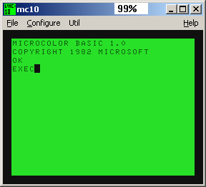
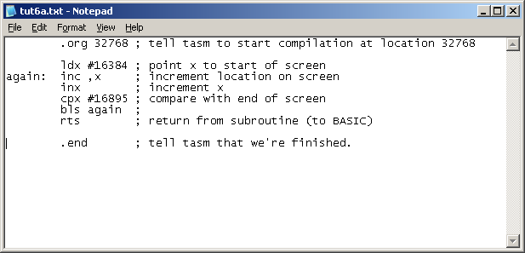
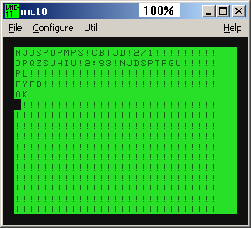
Example 6a
Increment all values on screen

Slide 69
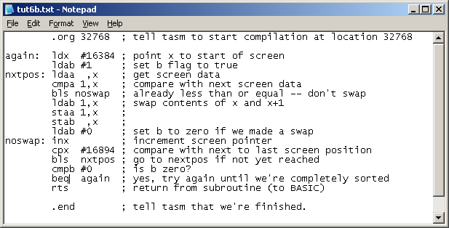
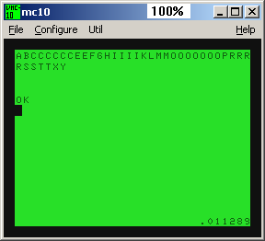
Example 6b screen bubble sort

Slide 70
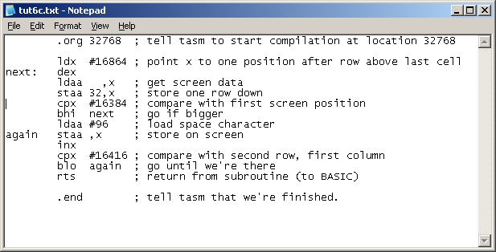

Example 6c
Reverse Scroll

Slide 71
Tutorial #7
Mask Instructions
aba beq bra daa jmp mul rol staa tst
abx bne brn dec jsr rola stab tsta
adca bcc deca neg rolb std tstb
adcb bcs cba decb ldaa nega ror sts
adda bhi clc des ldab negb rora stx wai
addb bhs cli dex ldd nop rorb suba
addd blo clr lds rti subb
anda bls clra eora ldx oraa rts subd
andb bge clrb eorb lsl orab swi
asr bgt clv lsla sba
asra ble cmpa inc lslb psha sbca tab
asrb blt cmpb inca lsld pshb sbcb tap
bmi cpx incb lsr pshx sec tba
bita bpl com ins lsra pula sei tpa
bitb bvc coma inx lsrb pulb sev tsx
bsr bvs comb lsrd pulx txs

Slide 72
And, Or, Eor
These are bitwise operations with the usual properties:
  And with 0 -> 0.
  Or with 1 -> 1.
  Eor with 1 -> flip the value.
  Otherwise, leave value unchanged.
They work on either the A or B register (anda, andb, oraa, orab, eora, eorb).

Slide 73
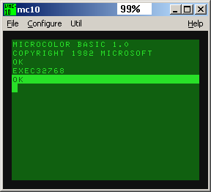
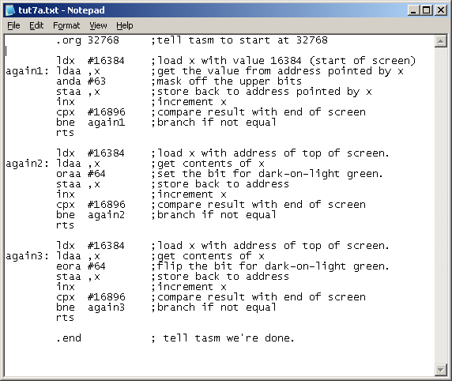
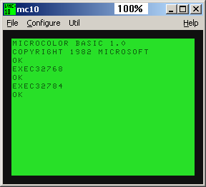
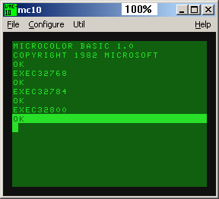
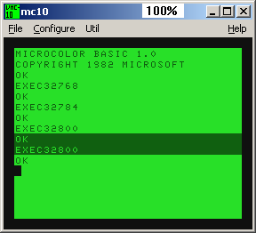

Slide 74
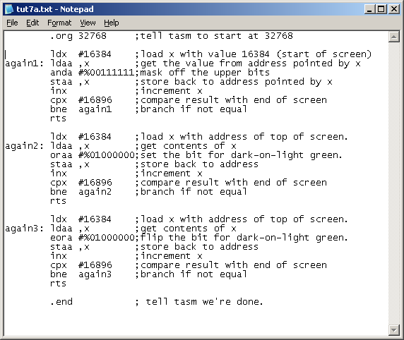
Binary constants and ‘%’.
You can type in a binary number directly by using the ‘%’ prefix.

Slide 75
Bit
Same as “anda” or an “andb” instruction except the result is discarded.
The condition codes can be used to inspect if certain bits were set.
Since the result is discarded, you can check the A or B register for various bits without needing to save the value.

Slide 76
Bit Example
ldaa #%00110110 ; % is binary prefix
bita #%01000000 ; see if bit 6 is set.
bne bitwasset ; go if bit 6 was set.
bita #%10001000 ; set if either bit 7 or 4 is set.
beq bothwerezero ; go if both bits were zero

Slide 77
Tst
Sets the N and Z condition codes depending on the data.
You can test the A or B registers (tsta, tstb), or a value in memory (tst)

Slide 78
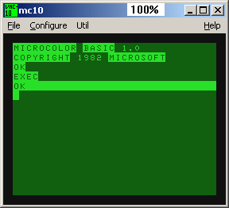
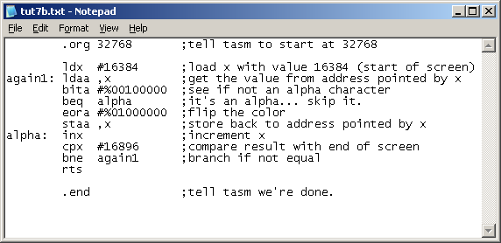
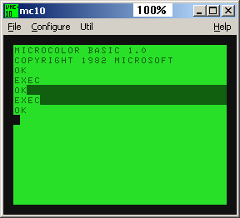
Bit example

Slide 79
Reading the keyboard
Reading the keyboard involves writing to location 2 and reading from either location 49151 or 3.
The keys are grouped in sections of 8.
You’ll use logic-0 values to determine which key is pressed.

Slide 80
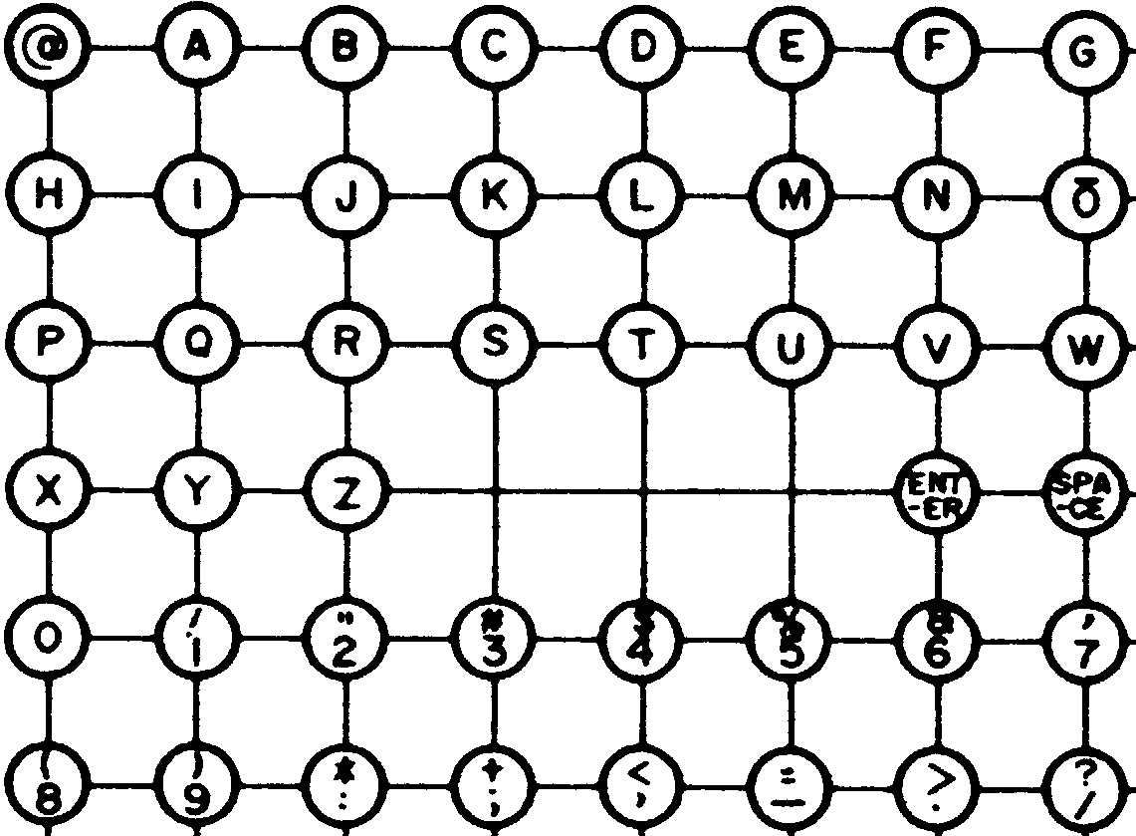
Keys associated with 49151
0
1
2
3
4
5
6
7
0
1
2
3
4
5

Slide 81
Example: is “L” pressed?
bits to inspect (write to 2)
0
1
2
3
4
5
6
7
0
1
2
corresponding bit
(read from 49151)
3
4
5
ldaa #%11101111 ;bit 4 corresponds to ‘L’
staa 2
ldaa 49151
bita #%00000010
beq keypressed

Slide 82
Example: is “X” pressed?
bits to inspect (write to 2)
0
1
2
3
4
5
6
7
0
1
2
corresponding bit
(read from 49151)
3
4
5
ldaa #%11111110 ;bit 0 corresponds to ‘X’
staa 2
ldaa 49151
bita #%00001000
beq keypressed

Slide 83
Example: Direction keys?
ldaa #%01111111
staa 2
ldaa 49151
bita #%00000100
beq keyW
ldaa #%11111011
staa 2
ldaa 49151
bita #%00001000
beq keyZ
ldaa #%11111101
staa 2
ldaa 49151
bita #%00000001
beq keyA
ldaa #%11110111
staa 2
ldaa 49151
bita #%00000100
beq keyS
0
1
2
3
4
5
6
7
0
1
2
3
4
5

Slide 84

Keys associated with 3
bits to inspect (write to 2)
0
1
2
3
4
5
6
7
corresponding bit
(read from 3)
1
;is BREAK pressed?
ldaa #%11111011 ;bit 2 corresponds to ‘break’
staa 2
ldaa 3
bita #%00000010 ;bit 1 cleared for CTL, BRK, and SHIFT
beq keypressed

Slide 85
Tutorial #8
Bit manipulation
aba beq bra daa jmp mul rol staa tst
abx bne brn dec jsr rola stab tsta
adca bcc deca neg rolb std tstb
adcb bcs cba decb ldaa nega ror sts
adda bhi clc des ldab negb rora stx wai
addb bhs cli dex ldd nop rorb suba
addd blo clr lds rti subb
anda bls clra eora ldx oraa rts subd
andb bge clrb eorb lsl orab swi
asr bgt clv lsla sba
asra ble cmpa inc lslb psha sbca tab
asrb blt cmpb inca lsld pshb sbcb tap
bmi cpx incb lsr pshx sec tba
bita bpl com ins lsra pula sei tpa
bitb bvc coma inx lsrb pulb sev tsx
bsr bvs comb lsrd pulx txs

Slide 86
Clear Instructions
Equivalent to loading A or B with zero (clra, clrb)
You may clear a memory address directly through either the extended or indexed modes (clr)

Slide 87
Complement Instructions
Flips all the bits in either an accumulator (coma, comb) or register or memory address (com)

Slide 88
Logical Shifting
A quick way of multiplying/dividing an unsigned number by 2.
You can shift the accumulators or memory left/right by 1 bit.
(lsla, lslb, lsld, lsl; lsra, lsrb, lsrd, lsr)
Zero is shifted in, and the remaining bit is shifted into the carry.
lsl
C
0
×2
lsr
0
C
÷2

Slide 89
Arithmetic Shift Right
A quick way of dividing a signed number by 2.
You can shift the A or B accumulator or memory right by 1 bit. (asra, asrb, asr)
The “sign” bit is left unchanged, and the remaining bit is shifted into the carry.
Signed multiplication by 2 can be done using the lsl instructions
asr
C
÷2

Slide 90
Rotating through the carry
You can shift the A or B accumulator or memory left/right by 1 bit.
(rola, rolb, rol; rora, rorb, ror)
The carry is shifted in, and the remaining bit is shifted into the carry.
rol
C
ror
C

Slide 91
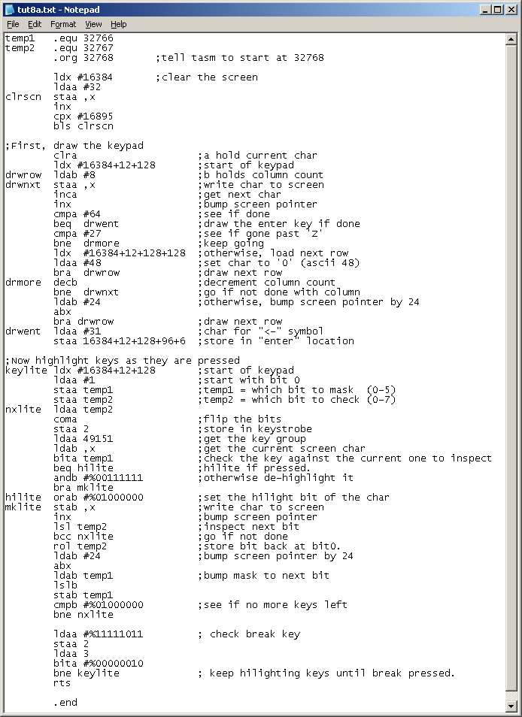
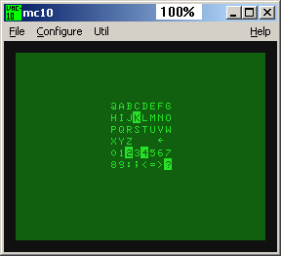
Keyboard Strobe
Example

Slide 92
Video Modes
The MC6847 is capable of two major modes of execution
  Major Mode 1:
  A fully-interchangeable 32x16 character format
  Major mode 2:
  A dedicated graphics mode

Slide 93
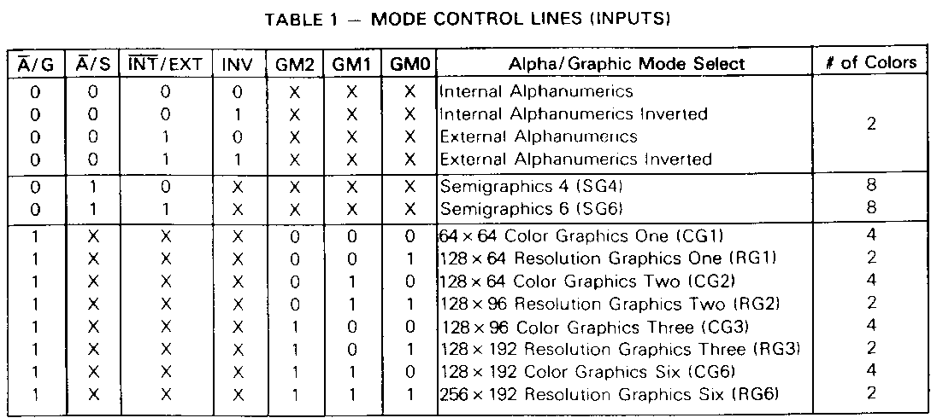
Video Control
49151
($BFFF)
7
6
5
4
3
2
1
0
Sound
CSS
A/G
GM0
GM1
GM2
INT/EXT
N/C
N/C
The MC6847 INT/EXT pin is physically tied to the GM2 pin.
Clearing bit 5 of the control register puts the MC6847 into “Major Mode 1” which can display basic text and limited graphics characters.
Setting bit 5 of the control register puts the MC6847 into “Major Mode 2” which is divided into a two color (resolution graphics) or four color (color graphics) mode.

Slide 94
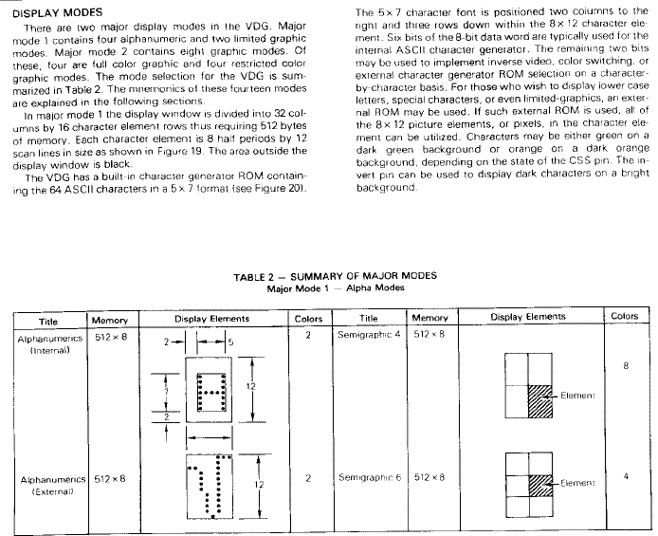
6847 Major Mode 1

Slide 95
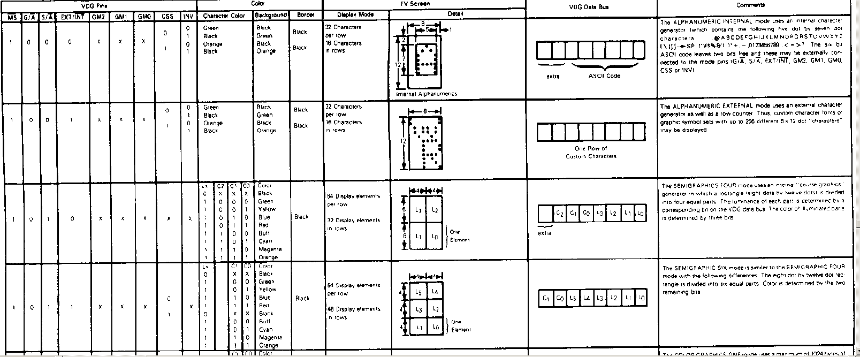
6847 Major Mode 1
The MC6847 is capable of simultaneously displaying the following all on the same screen on a character-by-character basis:
  64 Internally or 64 externally generated alpha-numeric characters of any of the four color schemes
    Dark green on light green
    Light green on dark green
    Dark orange on light orange
    Light orange on dark orange
  Any 2x2 or 2x3 graphics character of any one of the eight colors on black
  (512 alpha-numerics + 1024 graphics characters = 1152 possible characters)
  [This would correspond to 11 (really 10.5) bits to uniquely specify each character]

Slide 96
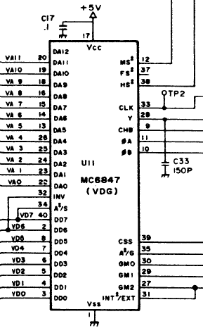
6847 Major Mode 1
The MC-10 uses only 8-bits to specify the characters in major mode 1.
  bit7 of the incoming data character is wired to control the A/S line. This lets you switch between semi-graphics and alpha-numeric characters
  bit 6 of the incoming data character is set to control the INV line (which is used in alpha-numeric mode to determine if a character’s color scheme is inverted)

Slide 97
6847 Major Mode 1
The remaining control pins that govern the first major mode (CSS, INT/EXT) are governed by writing to the Video Control register and are not selectable by the data character.
Only text and inverted text of one color can be displayed on the screen with any 2x2 any-colored-character block because the color select pin (CSS) is globally settable.
Having the CSS restricted to a global setting restricts the color palette of the 2x3 blocks to either green-yellow-blue-red or buff-cyan-magenta-orange.
Since bit 7 of the incoming data character is tied to the A/S pin, the color selection of the 2x3 blocks are restricted to either red/blue or magenta/orange.
Since the INT/EXT line is also globally settable, the 2x3 character blocks must be used in conjunction with the mode for an external character ROM. When bit7 goes low, the chip tries to use the external character ROM (which is not implemented on the MC-10).

Slide 98
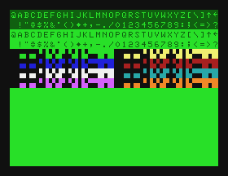
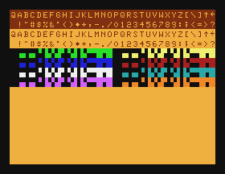
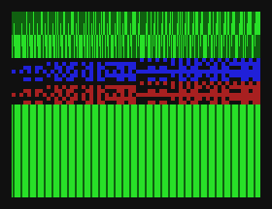
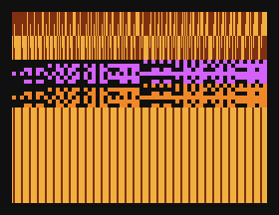
Major Mode 1 store at $BFFF (49151)
SG4 64x32
$4000-$41FF
16384-16895
$BFFF←$00
POKE 49151, 0
SG4 64x32
$4000-$41FF
16384-16895
$BFFF←$40
POKE 49151,64
SG6 64x48
$4000-$41FF
16384-16895
$BFFF←$0C
POKE 49151,12
SG6 64x48
$4000-$41FF
16384-16895
$BFFF←$4C
POKE 49151,74

Slide 99
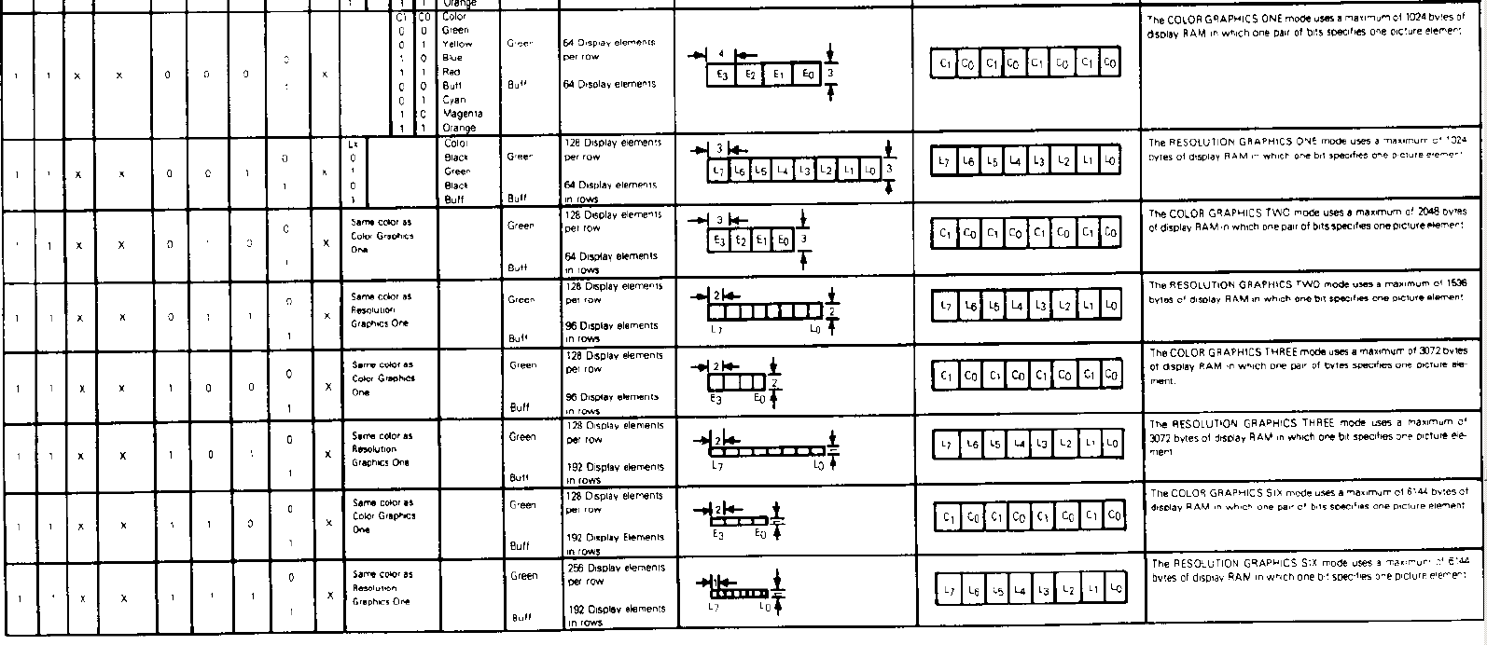
Major Mode 2
Since the CSS pin is globally settable only one palette at a time is displayed on-screen for the graphics modes.
  Resolution graphics modes: green/dark green or buff/black
  Color graphics modes: green-yellow-blue-red or buff-cyan-magenta-orange
The MC6847 would otherwise allow you to switch between these color schemes horizontally every eight cells (resolution graphics) or four cells (color graphics)

Slide 100
Major Mode 2
The on-board Video RAM for the MC-10 is 4K in size (12 bit address: $4000-$4FFF).
Thus only 12 of the 13 address lines were wired to the MC6847. (DA12 is unconnected)
CG6 and RG6 will paint data from $4000 - $47FF instead of $5000 - $57FF.

Slide 101
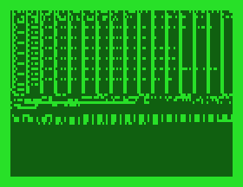

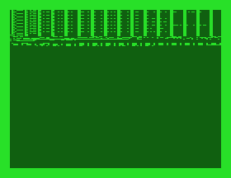
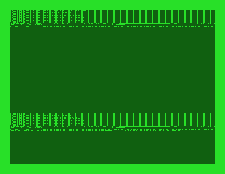
Major Mode 2 store at $BFFF (49151)
RG1 128x64
$4000-$43FF
16384-17407
$BFFF←$30
POKE 49151,48
RG2 128x96
$4000-$45FF
16384-17919
$BFFF←$38
POKE 49151,56
RG3 128x192
$4000-$4BFF
16384-19455
$BFFF←$34
POKE 49151,52
RG6 256x192
$4000-$4FFF
16384-20479
$BFFF←$3C
POKE 49151,60

Slide 102
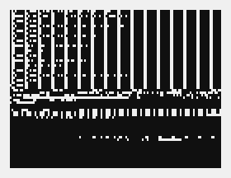



Major Mode 2 store at $BFFF (49151)
RG1 128x64
$4000-$43FF
16384-17407
$BFFF←$70
POKE 49151,112
RG2 128x96
$4000-$45FF
16384-17919
$BFFF←$78
POKE 49151,120
RG3 128x192
$4000-$4BFF
16384-19455
$BFFF←$74
POKE 49151,116
RG6 256x192
$4000-$4FFF
16384-20479
$BFFF←$7C
POKE 49151,124

Slide 103




Major Mode 2 store at $BFFF (49151)
CG1 64x64
$4000-$43FF
16384-17407
$BFFF←$20
POKE 49151,32
49151
($BFFF)
CG2 128x64
$4000-$47FF
16384-18431
$BFFF←$28
POKE 49151,40
CG3 128x96
$4000-$4BFF
16384-19455
$BFFF←$24
POKE 49151,36
CG6 128x192
$4000-$4FFF
16384-20479
$BFFF←$2C
POKE 49151,44

Slide 104




Major Mode 2 store at $BFFF (49151)
CG1 64x64
$4000-$43FF
16384-17407
$BFFF←$60
POKE 49151,96
CG2 128x64
$4000-$47FF
16384-18431
$BFFF←$68
POKE 49151,104
CG3 128x96
$4000-$4BFF
16384-19455
$BFFF←$64
POKE 49151,100
CG6 128x192
$4000-$4FFF
16384-20479
$BFFF←$6C
POKE 49151,108

Slide 105



Rotating the screen

Slide 106
Tutorial #9
Multi-byte math
aba beq bra daa jmp mul rol staa tst
abx bne brn dec jsr rola stab tsta
adca bcc deca neg rolb std tstb
adcb bcs cba decb ldaa nega ror sts
adda bhi clc des ldab negb rora stx wai
addb bhs cli dex ldd nop rorb suba
addd blo clr lds rti subb
anda bls clra eora ldx oraa rts subd
andb bge clrb eorb lsl orab swi
asr bgt clv lsla sba
asra ble cmpa inc lslb psha sbca tab
asrb blt cmpb inca lsld pshb sbcb tap
bmi cpx incb lsr pshx sec tba
bita bpl com ins lsra pula sei tpa
bitb bvc coma inx lsrb pulb sev tsx
bsr bvs comb lsrd pulx txs

Slide 107
Adding with Carry
The add with carry instructions (adca, adcb) will add the A or B register with the carry bit.
Since the carry is set when the result of an addition instruction doesn’t fit in 8 or 16 bits, you can use the adc instructions to continue adding the larger bytes.

Slide 108
Adding with Carry
Byte_a3
Byte_a2
Byte_a1
Byte_a0
Byte_b3
Byte_b2
Byte_b1
Byte_b0
Byte_c3
Byte_c2
Byte_c1
Byte_c0
ldaa Byte_a0 ;get least significant byte
adda Byte_b0 ;add with corresponding byte (carry set if result rolled over)
staa Byte_c0 ;store result
ldaa Byte_a1 ;get next significant byte
adca Byte_b1 ;add with corresponding byte (+1 if carry bit set)
staa Byte_c1 ;store result
ldaa Byte_a2 ;carrying forward...
adca Byte_b2
staa Byte_c2
ldaa Byte_a3 ;carrying forward...
adca Byte_b3
staa Byte_c3

Slide 109
Subtracting with Carry
The subtract with carry instructions (sbca, sbcb) will subtract from the A or B register along with the carry bit.
Since the carry is set when the result of an subtraction instruction doesn’t fit in 8 or 16 bits, you can use the sbc instructions to continue subtracting the larger bytes.

Slide 110
Subtracting with Carry
Byte_a3
Byte_a2
Byte_a1
Byte_a0
Byte_b3
Byte_b2
Byte_b1
Byte_b0
Byte_c3
Byte_c2
Byte_c1
Byte_c0
ldaa Byte_a0 ;get least significant byte
suba Byte_b0 ;subtract corresponding byte (carry set if result rolled over)
staa Byte_c0 ;store result
ldaa Byte_a1 ;get next significant byte
sbca Byte_b1 ;subtract corresponding byte (additional -1 if carry bit set)
staa Byte_c1 ;store result
ldaa Byte_a2 ;carrying forward...
sbca Byte_b2
staa Byte_c2
ldaa Byte_a3 ;carrying forward...
sbca Byte_b3
staa Byte_c3

Slide 111
Multiply Instruction
Multiplies register A with B and stores the result back into the D register.
It assumes A and B are unsigned.
Since the largest possible multiplication is 255 x 255 = 65025, the result will always fit into the D register

Slide 112
Multi-byte Multiplication
Can be performed similar to long multiplication
  Compute product of pairs of bytes
  Add the results together

Slide 113
Example: Multiply the two 16-bit numbers stored at M and N and save the product at location P.
(from http://www.cs.ucf.edu/~tkocak/eel4767/lec4.ppt)
First, rewrite M and N as MHML and NHNL
where
  MH and NH are upper 8 bits of M and N respectively
  ML and NL are lower 8 bits of M and N respectively
MH and ML are stored at M and M+1 respectively
NH and NL are stored at N and N+1 respectively

Slide 114
Illustration
16-bit by 16-bit multiplication
(from http://www.cs.ucf.edu/~tkocak/eel4767/lec4.ppt)
8-bit 8-bit 8-bit 8-bit
upper byte lower byte
M_{L}N_{L}
upper byte lower byte
M_{H}N_{L}
M_{L}N_{H}
M_{H}N_{H}
M × N
upper byte lower byte
upper byte lower byte
address P P+1 P+2 P+3
MSB LSB

Slide 115
Program:
Multiplying Two 16-bit Numbers
(from http://www.cs.ucf.edu/~tkocak/eel4767/lec4.ppt)
ldaa M+1 ; place ML in A
ldab N+1 ; place NL in B
mul ; compute ML × NL
std P+2 ; save ML × NL to memory locations P+2 and P+3
ldaa M ; place MH in A
ldab N ; place NH in B
mul ; compute MH × NH
std P ; save MH × NH to memory locations P and P+1
ldaa M ; place MH in A
ldab N+1 ; place NL in B
mul ; compute MH × NL
addd P+1 ; add MH × NL to memory locations P+1 and P+2
std P+1 ;
ldaa P ; add the C flag to memory location P
adca #0 ;
staa P ;
ldaa M+1 ; place ML in A
ldab N ; place NH in B
mul ; compute ML × NH
addd P+1 ; add ML × NH to memory locations P+1 and P+2
ldaa P ; add the C flag to memory location P
adca #0 ;
staa P ;

Slide 116
Tutorial #10
Stack Operations
aba beq bra daa jmp mul rol staa tst
abx bne brn dec jsr rola stab tsta
adca bcc deca neg rolb std tstb
adcb bcs cba decb ldaa nega ror sts
adda bhi clc des ldab negb rora stx wai
addb bhs cli dex ldd nop rorb suba
addd blo clr lds rti subb
anda bls clra eora ldx oraa rts subd
andb bge clrb eorb lsl orab swi
asr bgt clv lsla sba
asra ble cmpa inc lslb psha sbca tab
asrb blt cmpb inca lsld pshb sbcb tap
bmi cpx incb lsr pshx sec tba
bita bpl com ins lsra pula sei tpa
bitb bvc coma inx lsrb pulb sev tsx
bsr bvs comb lsrd pulx txs

Slide 117
The Stack
Contiguous area of memory used to keep track of subroutines and temporary variables.
It grows and shrinks from one end.
The S register points to the first empty byte at the top.
S
top
bottom

Slide 118
Writing to the Stack
When you save (or “push”) bytes to the stack, the 6803 will
  decrement the S register by the number of bytes
  Store the bytes to the top of the stack
S
S
top
S
top
byte2
top
byte1
byte1
bottom
bottom
bottom

Slide 119
Reading from the Stack
When you retrieve (or “pull”) bytes from the stack, the 6803 will
  get the bytes to the top of the stack
  increment the S register by the number of bytes
S
top
S
byte2
top
S
byte1
byte1
top
bottom
bottom
bottom

Slide 120
Basic stack instructions
You can:
  push/pull either accumulator to/from the stack (psha, pshb; pula, pulb)
  push/pull the index register to/from the stack (pshx, pulx)
  increment or decrement the stack pointer without any data transfer (ins, des)
The condition codes are not affected by these instructions.

Slide 121
Subroutines
You can either branch to a subroutine (bsr) or jump to a subroutine (jsr). The MC-10 will push the PC location of the next instruction to the stack, then jump to the specified destination.
Subroutines are finished with a return from subroutine instruction (rts) which pulls the previously saved location from the stack and jumps to the location.

Slide 122
Stack Philosophy
Use the stack
  to store intermediate variables.
  to protect or preserve register values between the caller and the subroutine

Slide 123
Tutorial #11
Transfer instructions
aba beq bra daa jmp mul rol staa tst
abx bne brn dec jsr rola stab tsta
adca bcc deca neg rolb std tstb
adcb bcs cba decb ldaa nega ror sts
adda bhi clc des ldab negb rora stx wai
addb bhs cli dex ldd nop rorb suba
addd blo clr lds rti subb
anda bls clra eora ldx oraa rts subd
andb bge clrb eorb lsl orab swi
asr bgt clv lsla sba
asra ble cmpa inc lslb psha sbca tab
asrb blt cmpb inca lsld pshb sbcb tap
bmi cpx incb lsr pshx sec tba
bita bpl com ins lsra pula sei tpa
bitb bvc coma inx lsrb pulb sev tsx
bsr bvs comb lsrd pulx txs

Slide 124
8-bit Transfers
You can transfer between accumulators
  tba transfer b to a
  tab transfer a to b
You can transfer condition codes
  tpa transfer condition codes to a
  tap transfer a to condition codes

Slide 125
16-bit Transfers
You can transfer the index/stack pointers
  tsx transfer (S+1) to X
  txs transfer (X-1) to S
The +1 and -1 occurs so that X will point to the top of stack, and S will point to the first empty byte.
S
Top (X)
0,X
1,X
2,X
3,X
4,X
…

Slide 126
There is no direct way to transfer between the X and D registers
You can push and pull the values of the X and D registers on the stack to load between them:
  Transfer X to D:
  pshx ;put X on stack
  pula ;load A with X’s high byte
  pulb ;load B with X’s low byte
  Transfer D to X:
  pshb ;put low-byte on stack
  psha ;put high-byte on stack
  pulx ;load X from stack

Slide 127
Transferring D to X
pshb psha pulx
S
S
top
top
A
S
B
B
top
bottom
bottom
bottom

Slide 128
Transferring X to D
pshx pula pulb
S
top
X (high)
S
top
S
X (low)
X (low)
top
bottom
bottom
bottom

Slide 129



Example hi-res graphics (128x96)
program similar to the “SPARKLE”
program in the MC-10 BASIC manual

Slide 130
Tutorial #12
Flags
aba beq bra daa jmp mul rol staa tst
abx bne brn dec jsr rola stab tsta
adca bcc deca neg rolb std tstb
adcb bcs cba decb ldaa nega ror sts
adda bhi clc des ldab negb rora stx wai
addb bhs cli dex ldd nop rorb suba
addd blo clr lds rti subb
anda bls clra eora ldx oraa rts subd
andb bge clrb eorb lsl orab swi
asr bgt clv lsla sba
asra ble cmpa inc lslb psha sbca tab
asrb blt cmpb inca lsld pshb sbcb tap
bmi cpx incb lsr pshx sec tba
bita bpl com ins lsra pula sei tpa
bitb bvc coma inx lsrb pulb sev tsx
bsr bvs comb lsrd pulx txs

Slide 131
Implicit Carry Flag Clearing
The carry is cleared by
  clr, clra, clrb
  tst, tsta, tstb
The carry is set by
  com, coma, comb

Slide 132
Implicit oVerflow clearing
The oVerflow flag is cleared by
  ldaa, ldab, ldd, ldx, lds
  staa, stab, std, stx, sts
  anda, oraa, eora, bita
  andb, orab, eorb, bitb
  clr, clra, clrb
  tst, tsta, tstb
  com, coma, comb
  tab, tba

Slide 133
Explicit Flag Clearing
You can explicitly set and clear certain condition code flags.
  Carry (sec, clc)
  oVerflow (sev, clv)
  Interrupt (sei, cli)

Slide 134
Using sec, clc, sev, clv
The C and V flags are sometimes
  set/cleared just before leaving a subroutine,
  then inspected by bcc, bcs, bvc and bvs instructions after returning to the calling routine
This helps serve as a fast way to provide status information to a calling routine.

Slide 135
Tutorial #13
Doing Nothing
aba beq bra daa jmp mul rol staa tst
abx bne brn dec jsr rola stab tsta
adca bcc deca neg rolb std tstb
adcb bcs cba decb ldaa nega ror sts
adda bhi clc des ldab negb rora stx wai
addb bhs cli dex ldd nop rorb suba
addd blo clr lds rti subb
anda bls clra eora ldx oraa rts subd
andb bge clrb eorb lsl orab swi
asr bgt clv lsla sba
asra ble cmpa inc lslb psha sbca tab
asrb blt cmpb inca lsld pshb sbcb tap
bmi cpx incb lsr pshx sec tba
bita bpl com ins lsra pula sei tpa
bitb bvc coma inx lsrb pulb sev tsx
bsr bvs comb lsrd pulx txs

Slide 136
The NOP instruction
This instruction does no operation
It occupies one byte
It is used as
  a timewaster
  padding for self-modifying code

Slide 137
The BRN instruction
This instruction never branches.
It is used as
  a timewaster
  padding for self-modifying code
  a convenient way to hide an instruction in the place of the single-byte offset.
It occupies two bytes.

Slide 138
Tutorial #14
Interrupts
aba beq bra daa jmp mul rol staa tst
abx bne brn dec jsr rola stab tsta
adca bcc deca neg rolb std tstb
adcb bcs cba decb ldaa nega ror sts
adda bhi clc des ldab negb rora stx wai
addb bhs cli dex ldd nop rorb suba
addd blo clr lds rti subb
anda bls clra eora ldx oraa rts subd
andb bge clrb eorb lsl orab swi
asr bgt clv lsla sba
asra ble cmpa inc lslb psha sbca tab
asrb blt cmpb inca lsld pshb sbcb tap
bmi cpx incb lsr pshx sec tba
bita bpl com ins lsra pula sei tpa
bitb bvc coma inx lsrb pulb sev tsx
bsr bvs comb lsrd pulx txs

Slide 139
Interrupts
Caused by various conditions
All but two can be disabled by setting the Interrupt condition code flag.
When an interrupt occurs
  the Interrupt flag is set
  all registers are pushed on the stack
  program execution jumps to a specified location in memory

Slide 140
Interrupts
There are seven kinds of interrupts
(in ascending order of priority).
  Type Address Description
  SCI 16896 serial communication interface
  TOF 16899 timer overflow
  OCF 16902 output compare flag
  ICF 16905 input capture flag
  IRQ1 16908 interrupt-request 1
  SWI 16911 software interrupt
  NMI 16914 non-maskable interrupt
The Virtual MC-10 only emulates the SWI, OCF and TOF interrupts

Slide 141
SCI
The Serial Communications Interface is not used by the MC-10.
It is not emulated by the Virtual MC-10.

Slide 142
TOF
The timer overflow flag is set when the counter contains all ones (65535), and will jump to its address if the Interrupt flag is clear.
TOF is cleared by reading from memory location 9 (the counter).
The Virtual MC-10 emulates this interrupt (I think).

Slide 143
OCF
The output capture flag IS used by the MC-10 and Virtual MC-10.
It gets set when the output compare register matches the free-running counter and will jump to its address if the Interrupt flag is clear.
You can enable it by setting bit 2 of the TCSR register (address 8)
OCF is cleared by reading the TCSR and then writing to the output compare register (locations 11 or 12) or during reset.
The Virtual MC-10 emulates this interrupt.

Slide 144
ICF
This interrupt is used when bit 0 of port 2 is configured as an input.
The MC-10 uses it instead as an output to the RS232C communication port, so this isn’t really used.
The Virtual MC-10 doesn’t use this interrupt.

Slide 145
IRQ1
This interrupt is not implemented by the MC-10.
The IRQ1 pin is tied through a pull-up resistor to +5V.

Slide 146
SWI
This is known as the software interrupt.
It is explicitly called by the user and will always jump to its address and it cannot be disabled by the interrupt flag
It is emulated by the Virtual MC-10

Slide 147
NMI
The non-maskable interrupt can be triggered from the expansion slot in the back of the MC-10.
It is not disabled by the Interrupt flag.
It jumps to location 16896.
The Virtual MC-10 does not make use of this interrupt

Slide 148
The WAI instruction
This instruction will save the registers to the stack, then wait for an interrupt.
This is good for waiting for a timer to expire if you have nothing else to do

Slide 149
The RTI instruction
When an interrupt is called it saves all the registers on the stack.
The RTI instruction will restore the registers and resume control back to the main program.
It is equivalent to the following series of instructions: pula, tap, pulb, pula, pulx, rts.

Slide 150
Sample Program
An audio recording was taken from the “The Princess Bride” and run through a low-pass filter.
The resulting waveform was truncated so that the speaker would be energized when the audio went “above zero” and de-energized when the audio goes “below zero” – not great for sound quality, but that’s all the MC-10 can do.
The results were encoded differentially, by recording how long it took the audio to cross zero – providing reasonable compression for use with the MC-10.

Slide 151

Sample Program
(Plays audio in the background)
Note: This program is large,
due to the amount of data,
so don’t forget to set the load
and EXEC addresses to 20483
If you try this program.

